Slide 1
Electricity Basics: Sources and Use

Slide 2
Resources and Use

Slide 3
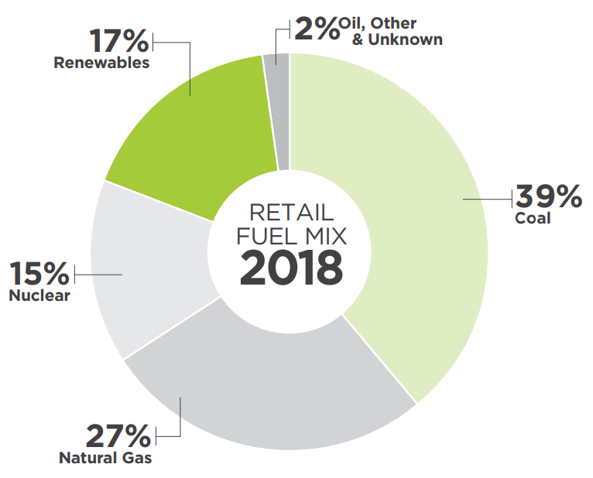
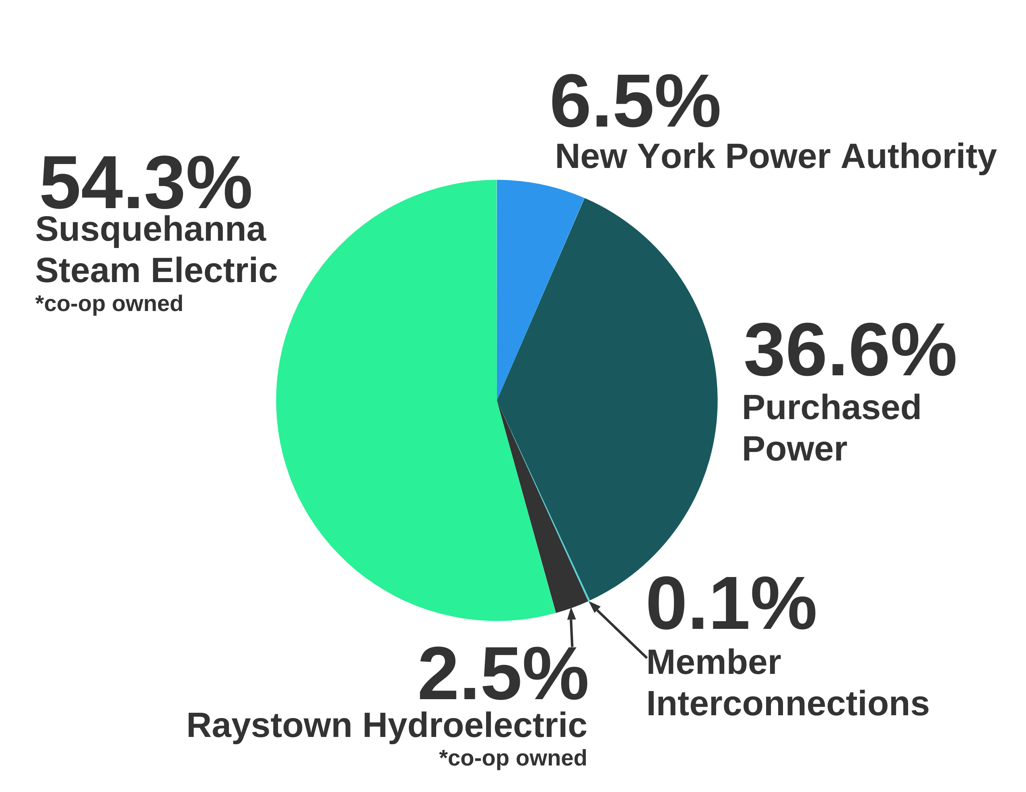
Powerful Energy Sources
Electric Co-op National
Energy
Portfolio
In 2022, Northwestern REC had the following power mix:
X% coal
X% natural gas
X% solar
X% hydro
Hydropower from Niagara River
Nuclear
Digester, solar, & wind
Notes:
Now that you know how power is delivered and the path it takes to reach end-of-the-line co-op members, let’s look at how it’s generated...
Electric co-ops and other utilities use electricity that’s generated from a variety of fuels – like fossil fuels and renewable sources.
Nationally, electric cooperatives and other utilities use a variety of fuels to power American homes and businesses. This diverse fuel mix supplies co-op members with the safe, reliable energy they depend on.
[Insert co-op name] uses [insert fuel sources and percentages].
Chart Source: NRECA Research

Slide 4
Renewable Energy
Co-op renewable energy capacity increased 151%,
from 4 gigawatts to 10
gigawatts in 2010-2019.
Nationally, electric co-ops plan to add 6 gigawatts of new renewable capacity from by 2023.
Notes:
Renewable sources of electricity, such as hydro, nuclear, wind and solar, are growing more rapidly than coal and other carbon sources.
Co-op members, especially younger members, want to know where their energy is coming from and how the co-op plans to increase its use of renewable energy in the future.
According to 2018 NRECA research, 17% of America’s electric cooperatives’ total generation comes from renewable energy sources.
[If your co-op has a renewable energy project, like community solar, consider including that information here, or insert a duplicate slide for “renewables” and add info about your co-op’s project/program.]

Slide 5
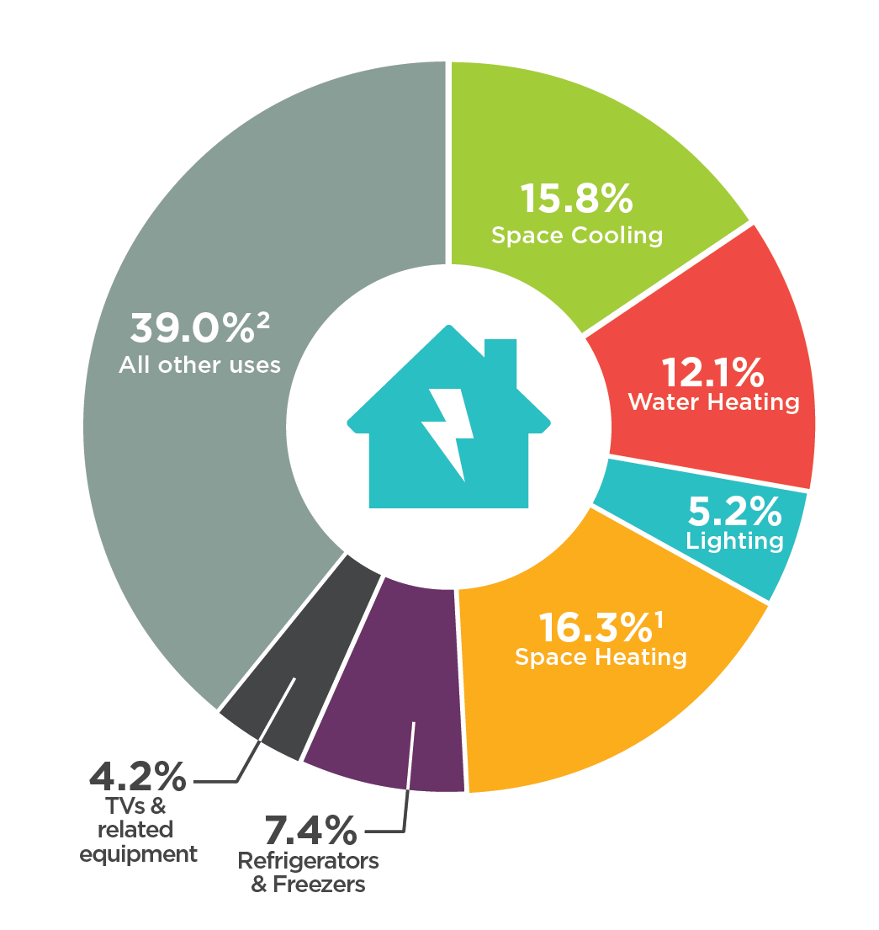
How Americans Use Electricity
The combined use of clothes washers and dryers, computers, dishwashers, small appliances and other electrical equipment accounts for nearly 40% of electricity consumption in American homes.
Notes:
As co-op employees, it’s important for us to understand how our members use electricity… after all, we’re here to help our members use energy wisely.
The latest data from the U.S. Energy Information Administration shows the combined use of clothes washers and dryers, computers, dishwashers, small appliances and other electrical equipment accounts for nearly 40% of electricity consumption in American homes. Armed with information about how our members are using electricity, we can better advise our members about how they can save energy and money.
Chart Source: EIA, Annual Energy Outlook 2020. 1) Includes consumption for heat and operating furnace fans and boiler pumps. 2) Includes miscellaneous appliances, clothes washers and dryers, computers and related equipment, stoves, dishwashers, heating elements, and motors.

Slide 6
Value

Slide 7
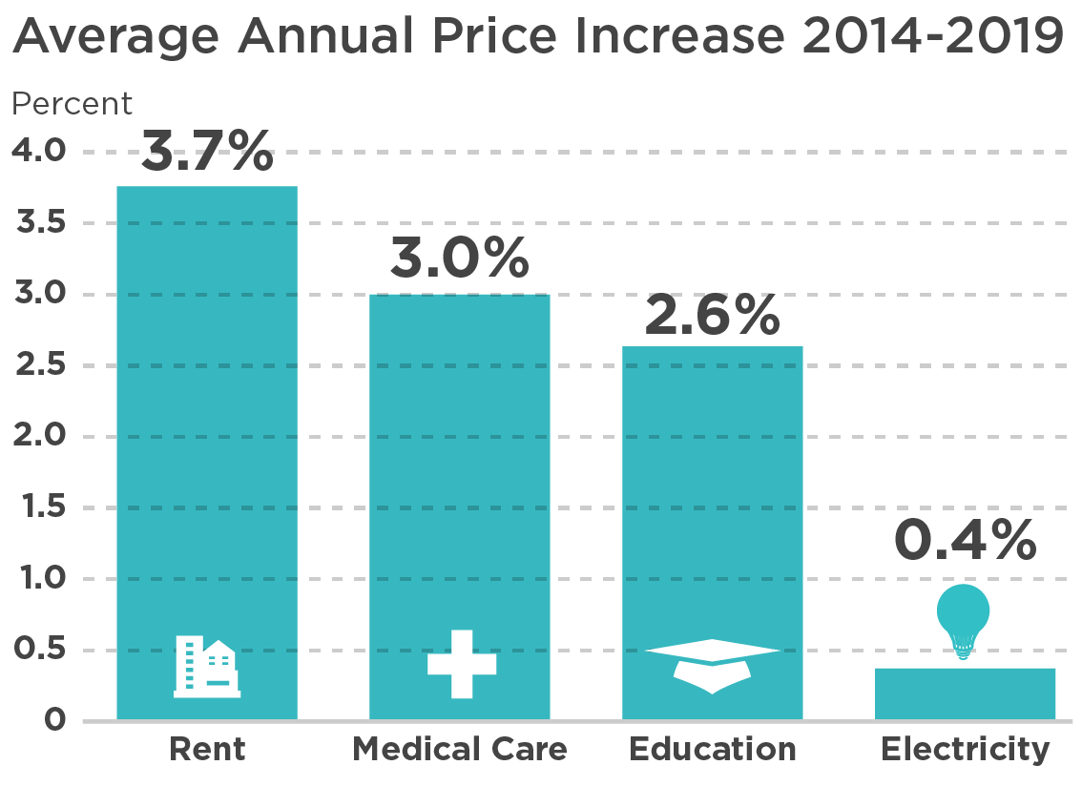
The Value of Electricity
When you look at price increases of common expenses over the last five years, it’s easy to see electricity remains a good value!
Notes:
Next, let’s talk about affordability.
The average American household is steadily paying less on electricity as a percentage of its income. In 2020, Americans are spending the lowest amount of their income on electricity ever.
This is a great message to share with our members as we work to keep costs down, especially as we think about the many ways we all rely on electricity every day.
Chart Source: U.S. Bureau of Labor Statistics Consumer Price Index

Slide 8
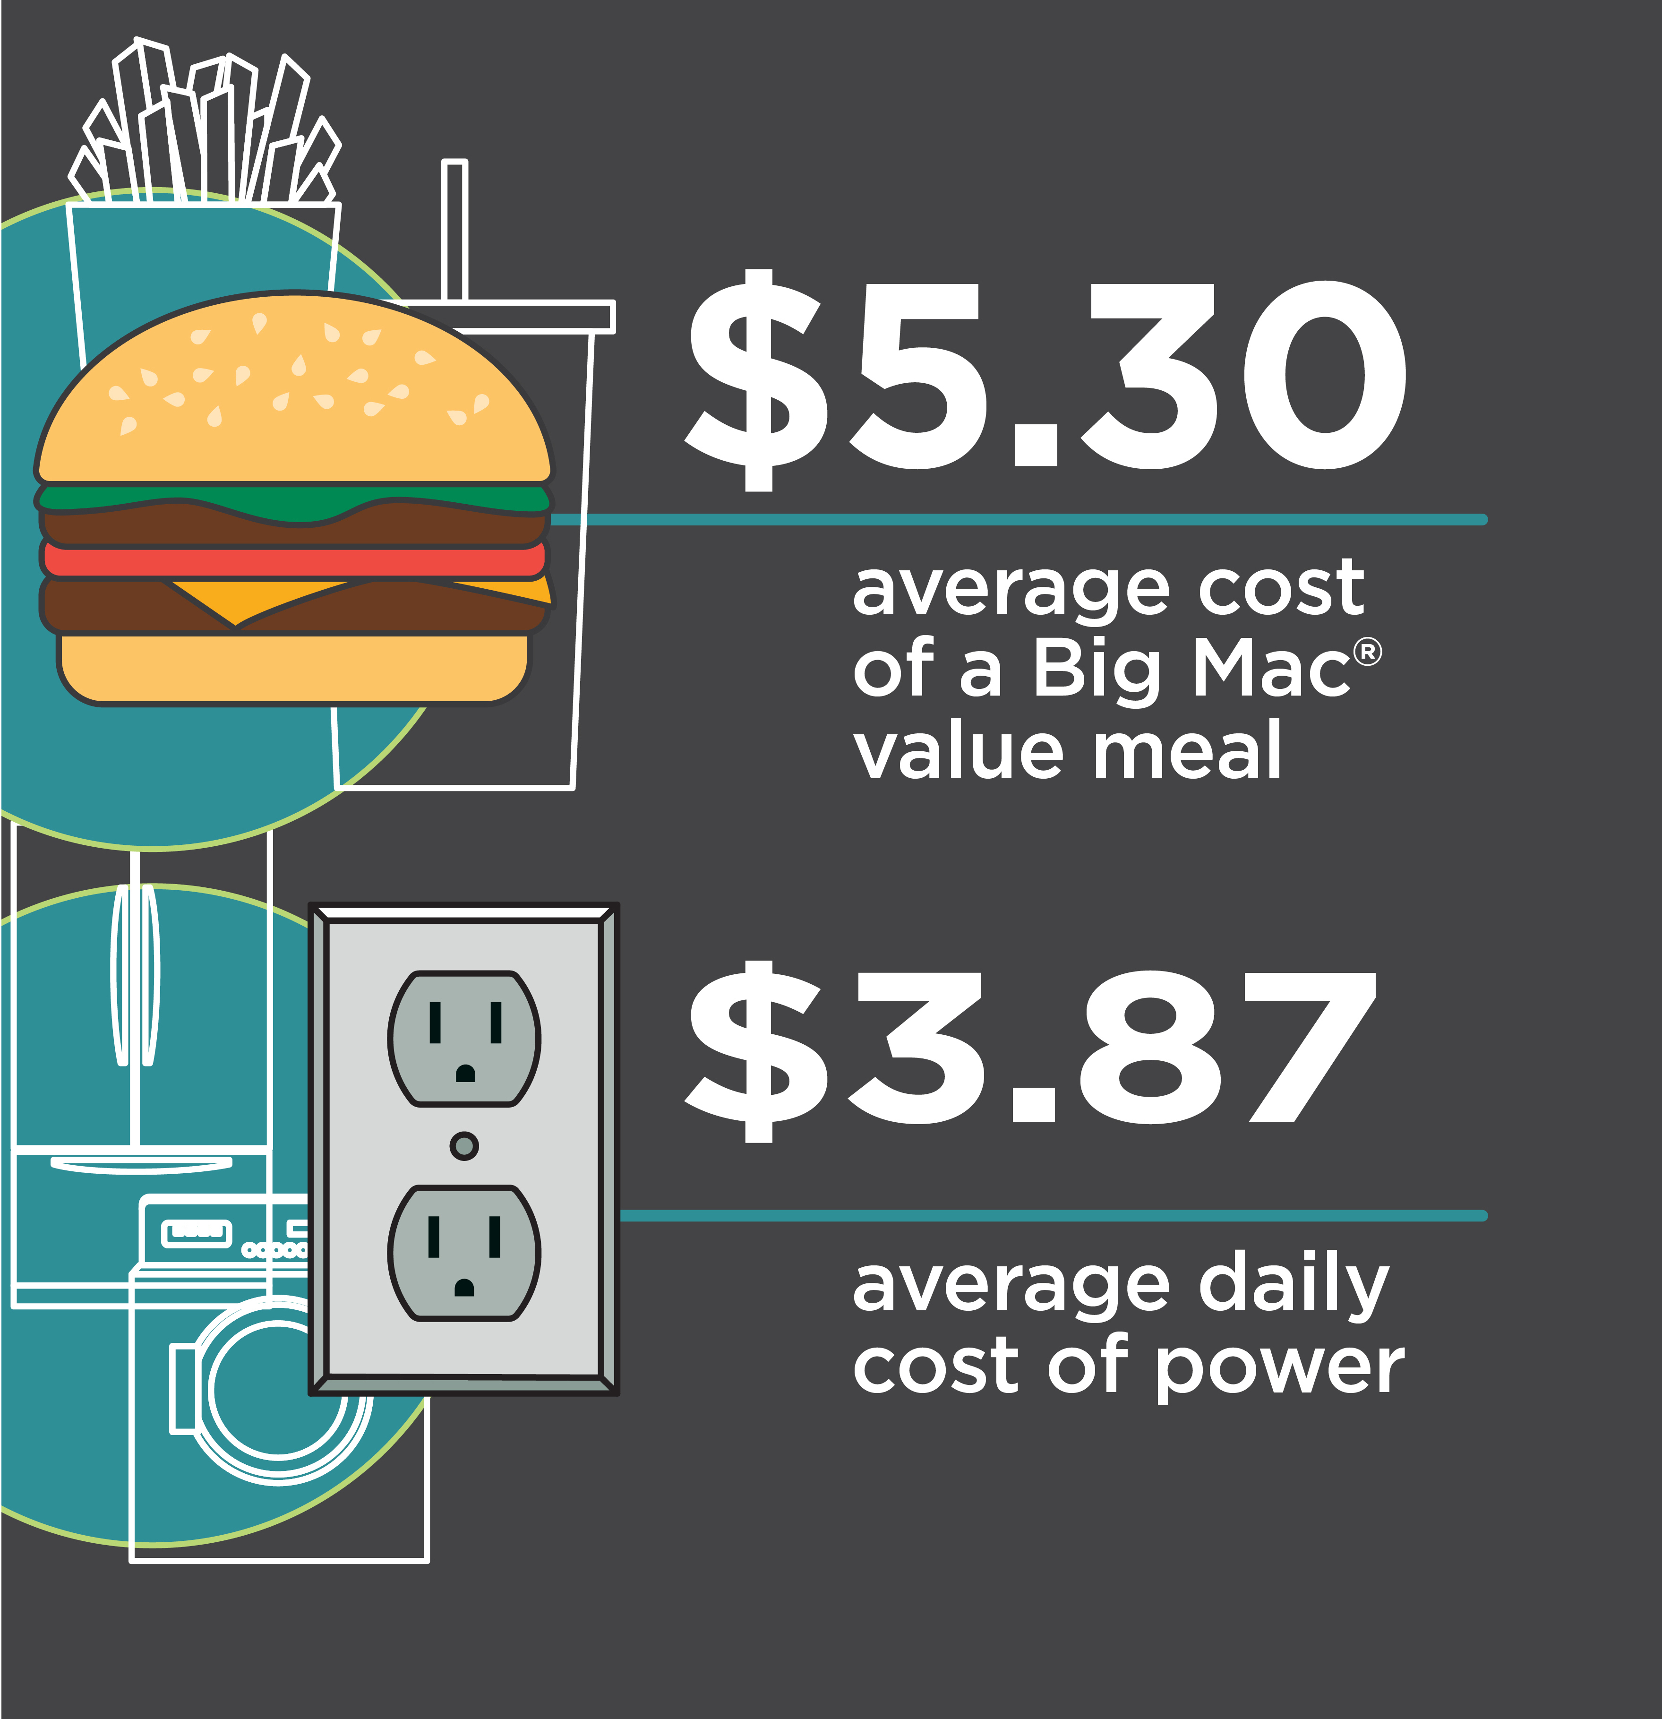
The Daily Cost of Electricity
A Big Mac® meal costs more than the average daily cost of home electricity.
Notes:
Speaking of using electricity each day, here’s another easy way to look at the value of electricity....
The average daily cost of power is less than a Big Mac® meal! When you think about all the ways we use electricity to power our daily lives, it’s clear to see electricity remains a good value.
This is another message we can share with our members – it’s easy to understand and helps put the value of electricity in perspective.
Note: Electricity is expressed on a daily basis using EIA 2018 Average U.S. Monthly Residential Bill of $117. Big Mac® is a registered trademark of McDonald’s Corporation. McDonald’s does not endorse or sponsor this material.

Slide 9
Trends

Slide 10
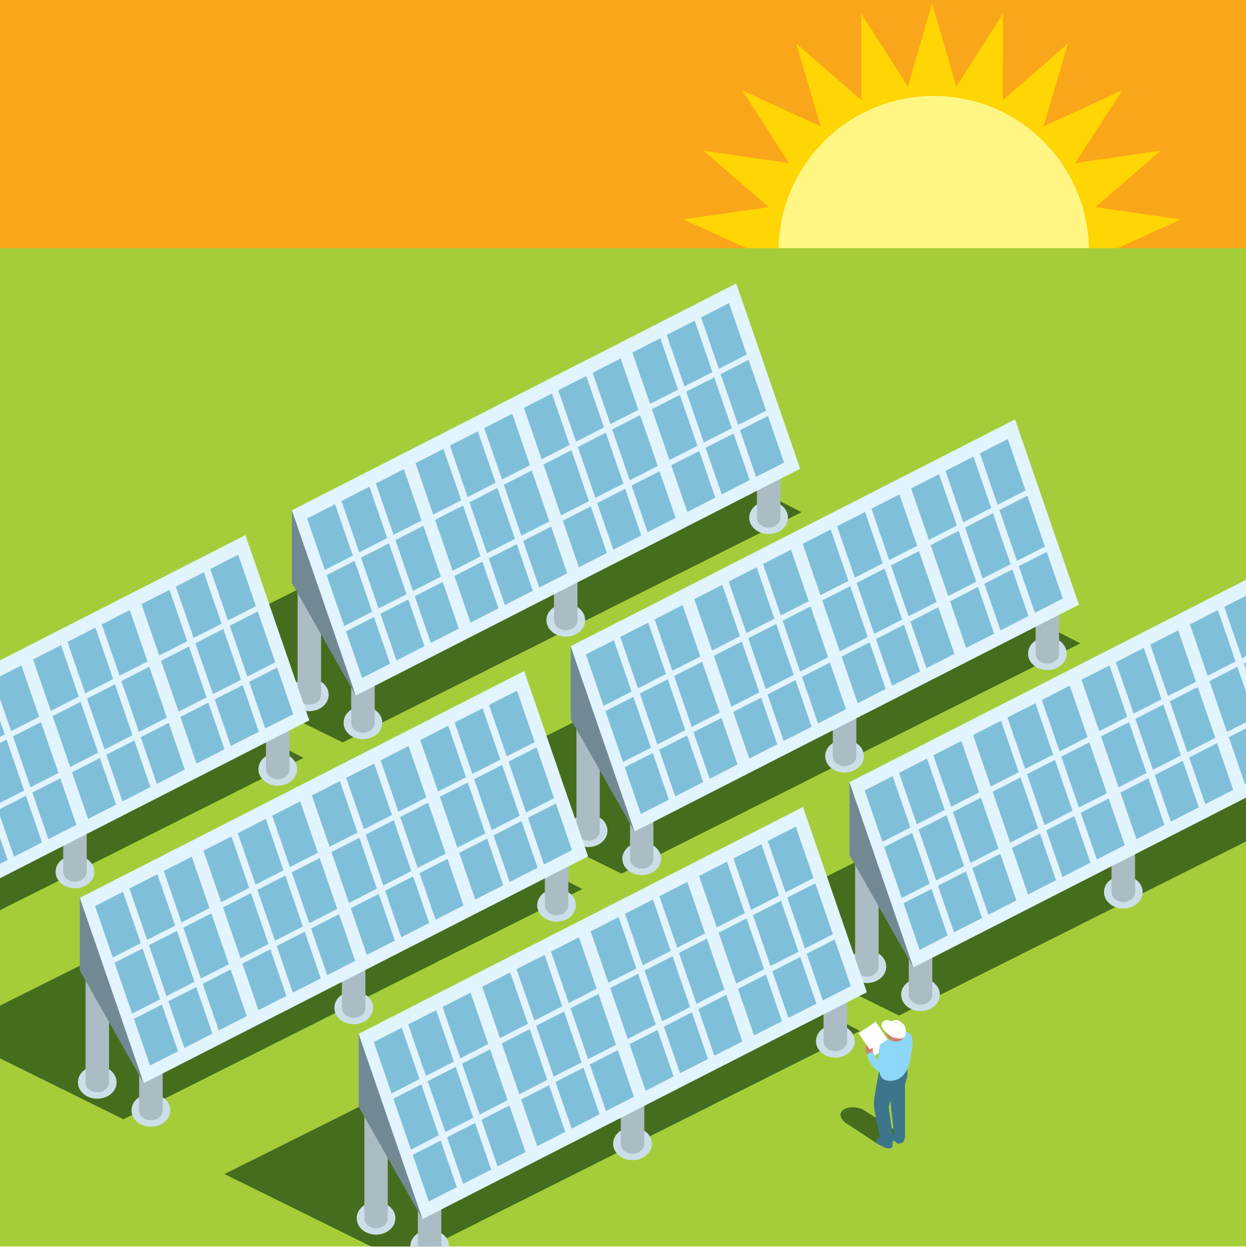
Distributed Energy Resources (DER)
Grid-connected generating technologies located close to where the electricity is being used.
Business and Residential examples:
Rooftop solar
Battery storage
Small hydro
Utility-scale examples:
Community solar
Battery storage
Microgrids
Notes:
Distributed energy systems are decentralized, flexible grid-connected technologies that typically involve renewable energy sources.
Distributed energy technologies are located close to where the electricity is being used and can serve as supplement to or an enhancement of the traditional electric power system. Distributed energy generation allows co-op members to produce some or all of the electricity they need.
We encourage all members considering DER at their home or business to work with the co-op for proper grid integration.
Distributed energy generation systems can also be managed by the co-op, like a community solar installation.
[Insert DER examples or statistics from your co-op.]

Slide 11
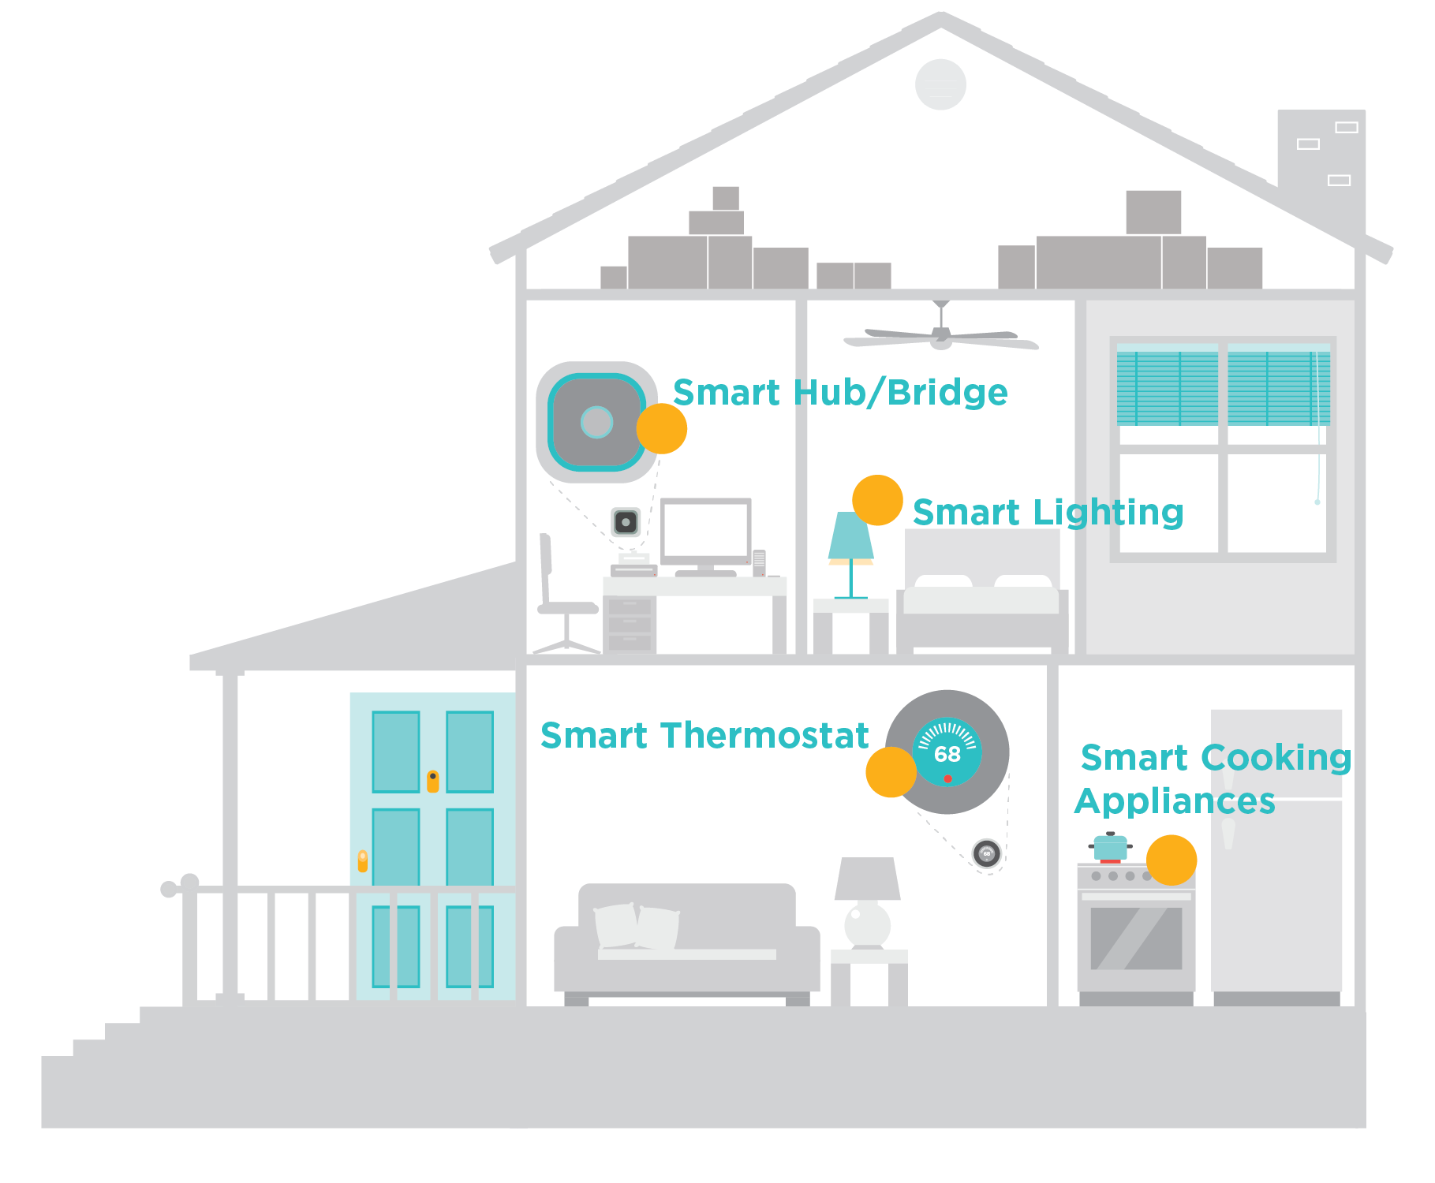
Smart Home Technologies
Through smart home technologies, our members have more control over how and when they use a variety of electronics, devices and appliances.
Notes:
Today’s smart home has blossomed to near Jetson-esque capabilities.
Applications for home automation continue to improve, fueled by the growth of the Internet of Things.
Smart technologies can be controlled by voice or mobile app, giving members more control over how they use these devices – even when away from home.
The most popular smart technologies today include smart thermostats, smart lighting and smart appliances.
Most of these technologies can be controlled through a smart hub or bridge, like Amazon Alexa or Google Assistant.
The smart devices impact our members as they are better able to control their energy use, such as setting their smart thermostat to adjust when they are not home, effectively saving members money on energy costs.
This impacts our cooperative, as we can leverage this to be trusted energy advisors for our members, and educate them about how and when they use electricity impacts the co-op’s bottom line, such as adjusting use during peak times. [Insert information about your co-op’s peak time rebates, time of use rates or beat the peak program if applicable.]

Slide 12
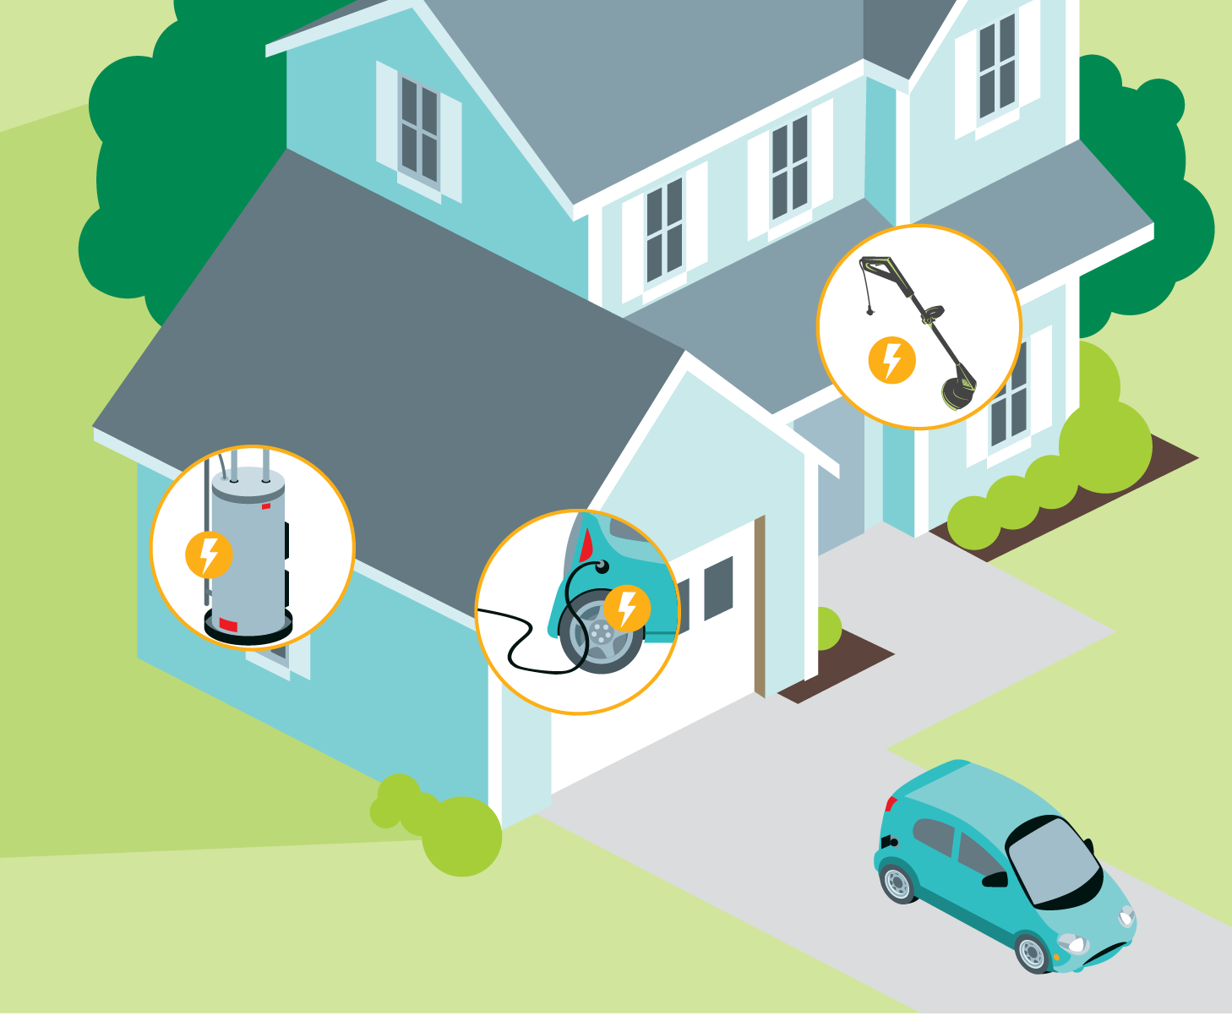
Beneficial Electrification
Members are choosing more electric options for:
Vehicles
Heat pumps
Lawn care equipment
Tools
Appliances
Notes:
The concept of “beneficial electrification” is another area that’s gaining traction.
Beneficial Electrification includes the application of electricity to end-uses where doing so satisfies at least one of the following conditions, without adversely affecting the others:
- Saves consumers money over time;
- Benefits the environment and reduces greenhouse gas emissions;
- Improves product quality or consumer quality of life;
- And fosters a more robust and resilient grid
Electricity is becoming cleaner and more renewable every day and can save consumers money on their total energy costs over time. Going electric can lower energy costs, help the environment and improve quality of life in local communities. It’s beneficial to members, the co-op and the environment.
As members move towards beneficial electrification, we are seeing them choose more electric options for their vehicles, heat pumps, lawn care equipment, tools and appliances.
… Now you have a good base of knowledge on energy sources and use at our co-op to help you understand the role we play in powering our community.

