Slide 1
Co-op 101
Why the co-op business model sets us apart from other utilities and traditional businesses
Notes:
When you were hired, it’s likely that many of you were just focused on securing a job – that’s totally understandable.
Because of our name, you probably knew you were going to work for a “CO-OP”, but you didn’t really focus on what that meant.
Today, we’re going to delve into what it means to be part of a co-op.
Specifically, we’re going to cover:
What a co-op is
What the cooperative difference is
Specific ways we operate differently than other standard utilities because we are a co-op and not an investor-owned or municipal utility
What adhering to co-op principles mean – not only to our members but to employees
And most importantly, what it means to members to be part of a co-op

Slide 2
Mission-Driven, Pragmatic Roots
Co-ops are created by community members to meet a need that is unmet in the community.
Electric co-ops were created because investor-owned utilities thought it was too expensive to enter into the rural market.
Electric co-ops have deep roots, but continue to evolve and grow to shape communities for the future.
Notes:
What are co-ops?
All electric co-ops were created out of necessity. They were created to meet a need that would have been otherwise unmet in the community.
Back in the day, our community didn’t have electricity even though cities did because it wasn’t profitable to bring electricity out to farmers in rural areas. So a group of neighbors banded together and organized our electric co-op so everyone in the community could benefit. For a modest membership fee to the co-op (maybe as low as $5), a farmer could get electricity brought to his farm. Neighbors came together to tackle a problem that they all had, but couldn’t solve alone. So they worked together for the benefit of the whole community.
While this history may be forgotten, key parts of that heritage remains – the focus on mission and serving the greater good; a spirit of innovation and self-help.
The innovation piece is a key driver for the cooperative. Since bringing electricity to our town decades ago we’ve continued to adapt to the world around us, and to the needs of our members and communities.
These mission-oriented roots mean our co-op is always looking for the next way to meet the needs of the community. For example, we do this by [INSERT EXAMPLES OF WHAT YOUR CO-OP DOES TO HELP THE COMMUNITY, i.e., Operation Round-up, local charitable orgs. the co-ops supports through financial or volunteer hours, local partnerships w/ schools and businesses etc.]. All co-ops are constantly striving to anticipate and plan for the future needs of their members and the community.
We remain mission-focused on providing an essential service in the community to help it thrive. Our focus is not on making excess revenue and profits, it’s on meeting the needs of our members and the community we serve.

Slide 3
More Than an Electric Utility
Notes:
At-a-glance look at the what drives traditional corporations and what drives co-ops
For perspective, this is a chart, courtesy of Co-ops for a Better World, that provides an at-a-glance contrast between what drives a traditional business and what drives a co-op. When you see the side-by-side comparison, you can easily see the differences between co-ops and traditional businesses.
I think the big take-away is that traditional businesses are about creating wealth for themselves and their shareholders. Their focus is primarily financial.
Cooperatives on the other hand are professionally run and of course must meet financial targets, but that is not their sole focus – it’s their members and serving the community.
Co-ops are fair, transparent and equitable. We believe that when we work together for mutual benefit, everyone thrives.

Slide 4
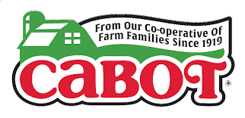
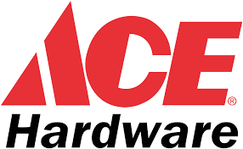
The Golden Thread for All Cooperatives
All co-ops adhere to seven guiding principles that reflect core values of honesty, transparency, equity, inclusiveness and service to the greater community good.
Notes:
A common bond that all co-ops share
So we happen to be an ELECTRIC co-op because we sell energy.
But there are lots of types of co-ops. There are consumer co-ops like grocery co-ops and REI, because their members are comprised of their customers. There are also “Purchasing co-ops”, like ACE Hardware. This is a group of independently owned hardware stores that pool their money to buy inventory in bulk at lower rates. You also have producer co-ops, including farmer/agriculture co-ops like Land O’ Lakes), etc. And while all those different types of co-ops sell different products and services, we ALL have ONE SET OF PRINCIPLES that guide our businesses.
In other words, we may have different commodities, but our business model is the same as other co-ops, as we all operate based on the same seven cooperative principles.
For perspective, our co-op is one of more than 900 electric co-ops in 48 states. We power 56% of the nation’s land mass and power more than 20 million homes, farms and schools and serve more than 42 million people across 88% of the nation’s counties.
And, looking at co-ops even more broadly, in the U.S. alone*, there are nearly 64,000 co-ops; 130,000 members; 2.1 million employees (*stat. from 2019) , according to Co-ops for a Better World (2019),
So co-ops are all over and their impact is impressive.
NOTE on Purchasing co-ops: Ace Hardware, is a cooperative of independent hardware stores that pool their buying power to purchase inventory in bulk to benefit their consumer-members. This makes it a “purchasing” co-op.
NOTE on Consumer co-ops: REI is the largest consumer co-op in the country. Like some credit unions and food co-ops, its membership base is composed of its customers.
Note on Retailer-owned co-ops:
Like a purchasing cooperative, a retailer-owned cooperative pools the resources of individual store owners in a collective partnership. The local owners serve their communities, participate in the co-op’s decision-making and benefit from the organization’s success. ACE and REI are also considered Retailer-owned co-ops

Slide 5
Co-op Principles (and why they matter)
Voluntary membership
Democratic control
Member economic participation
Autonomy and independence
Education, training and information
Cooperation among cooperatives
Concern for community
Notes:
For co-ops, the story is not WHAT we do; it’s WHY we do it
To an outsider, a co-op may look the same as a traditional business. In our case, people may think of us as a “standard” utility. We PROVIDE ELECTRICITY just like an investor-owned utility does.
So the difference is not so much WHAT we do, as it is WHY we do it. And the “WHY” comes down to the co-op principles that guide us and are at the core of our business model.
I’m going to briefly run down what these 7 principles mean, and on the next few slides I’m going to call out a few of them. These are the words we live by. And remember, these 7 principles are what guide ALL co-ops, not just ours.

Slide 6
Closer Look: Voluntary Membership & Democratic Control
Notes:
BREAKING DOWN THE CO-OP PRINCIPLES
Voluntary Membership and & Led by Members
Principle #1: VOLUNTARY MEMBERSHIP
Any person who is willing to accept the responsibilities of co-op membership and who wishes to use the services of a cooperative is welcome to become a member. So in our case, everyone who pays their bill is a member. It’s also important to note that we don’t have “customers” we have “members.” The difference is when you are a member, you have more of a stake in the organization. You receive benefits through your membership.
Principle #2: DEMOCRATIC CONTROL
Co-ops are led by their members who understand and listen to the community. Our co-op is guided by the members who buy our products and services because they understand and listen to the community. Each member has an equal voice in co-op matters through their vote. Our co-op is different than others in the state or across the network because our community has different needs than others. While we may be part of a larger network of 900 co-ops, each is different because each one reflects the uniqueness of their community.

Slide 7
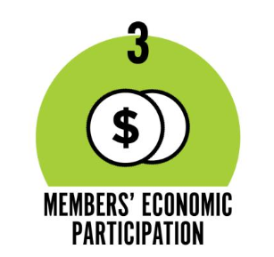
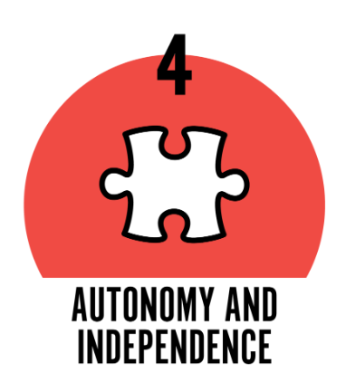
Closer Look: Member Economic Participation & Autonomy & Independence
Notes:
BREAKING DOWN THE CO-OP PRINCIPLES
Principle #3: MEMBER ECONOMIC PARTICIPATION:
Members contribute to the capital of the co-op fairly and equitably. Obviously our members do this through paying their bills. Most of the capital of a co-op stays in the co-op to benefit all members and is also reinvested – usually locally for the common good.
Principle #4: AUTONOMY & INDEPENDENCE
Co-ops belong to the communities they serve. They are also built by the communities they serve, so each cooperative is different depending on their community’s specific needs. The local nature of co-ops is also part of it’s appeal. They are not influenced by outside control.

Slide 8
Closer Look: Education, Training & Information
Investing in continuous learning for employees and board members means making a commitment to individual professional growth, the future of the co-op and the high quality of service our members expect and deserve.
NRECA training conference
Notes:
So- I want to take a closer look at three principles that are of particular importance for us. The first is Co-op Principle #6 “Education, training and information”
A cooperative provides education and training to its staff, members and board members to enable them to contribute to the development of the co-op.
Cooperatives seek to inform and educate the public about the mission and operation of a co-op. Because a more informed member is a more engaged member.
As we look at this principle, we know that by investing in continuous learning for our employees and board members, our co-op is making a commitment not just to individual professional and personal growth, but to the future of the co-op and the high quality of service our members expect and deserve. [INSERT EXAMPLES OF PROF. DEV. / TRAINING SESSIONS THAT THE CO-OPS SENDS STAFF TO OR HOSTS ETC.]
It’s a win-win situation. Let’s face it, we’re in a complex industry that is quickly changing. We want our employees, co-op leaders and our members to be more informed so that we can make thoughtful decisions that will benefit our community.

Slide 9
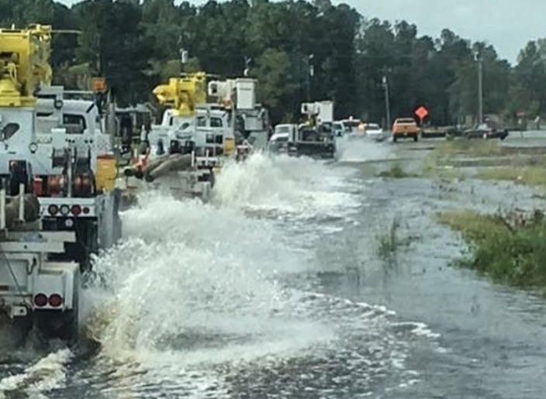
Closer Look: Cooperation Among Co-ops
Collaboration: A way co-ops work together to tackle bigger issues and challenges together.
Benefit: The ability of a co-op to access and share resources and leading practices with the larger network means local co-ops can learn from each other and gain from the experience.
Mutual aid during severe weather event
Notes:
Co-op Principle #6: “COOPERATION AMONG COOPERATIVES”
So this is a principle that applies to all co-op industries, but is especially relevant in our industry. I’m pretty sure that at some point, everyone in this room will benefit from this principle.
Cooperation among cooperatives is a way that co-ops work together to meet bigger challenges – in our case, we see this most frequently in power restoration after a severe weather event. But it also applies to combatting cyber threats or other big challenges that it’s harder to deal with on our own.
In terms of severe weather events -- our co-op offers assistance to neighboring co-ops impacted by severe weather just as we receive help when our community is in similar need.
In addition, because we are part of larger electric co-op network through our national organization (NRECA) we have access to resources that can help us improve the cyber and physical security of our co-op. This is an area where collaboration and cooperation is going to be even more important in the future.
As employees, you will likely find yourself tapping into the expertise of a colleague from another co-op. Or, you could be the one offering assistance to someone in the network. This is another way to look at cooperation among cooperatives. And it will help you work smarter, not harder.
[INSERT EXAMPLES OF HOW YOUR CO-OP HAS HELPED OTHER CO-OPS AND HOW YOUR CO-OP HAS BENEFITED FROM ASSISTANCE FROM ANOTHER CO-OP]

Slide 10
Closer Look: Concern for Community
The essential DNA of co-ops.
It’s all about the common good.
Because of the co-op business model, co-ops care about people over profits and are a catalyst for good in their communities.
Youth Tour
Notes:
So I saved the best for last – Co-op Principle #7: “CONCERN FOR COMMUNTY”
I definitely want to pause on this one because this principle is the essential DNA of co-ops. It represents our heart and soul and it sets us apart from other electric utilities and businesses. It’s what gives us our co-op advantage.
“Concern for community” – this is intuitive. It’s simple. We serve our community. Not only by being an essential service, but by helping to power our local economy and help it to thrive. Whether through community investments; through the volunteer hours that our employees contribute to local schools and charities; through direct donation to local causes; through investment in our area’s young people through scholarships or Youth Tour. [INSERT EXAMPLES OF WAYS THE CO-OP HAS HELPED THE COMMUNITY].We care about our community and we put this principle into action everyday – in ways small and large. It’s the core of who we are.
Co-ops are born of necessity. They are created by people who have a need and are willing to work together to operate and organize a company that will meet that need. Initially, innovation is required to achieve the goal.
And ultimately, the effort is all about the common good. According to the established co-op principles, policies approved by the members of the cooperative should help to develop and sustain the community. So it’s not about the money – it’s about the societal benefit.
Because of this mission-driven focus that is our co-op business model, we are a catalyst for good that spurs prosperity for our community. In other words, we bring good people together and we help make good things happen in our community, in our country and the world.

Slide 11
Connecting the Dots: Members
Member Values
Reliability
Responsiveness
Convenience
Transparency
Honesty
Respect
Value
Service
Authenticity
Notes:
Connecting the Dots – how being a co-op is particularly important to members
So I want to make the connection between the co-op principles I just talked about and our members.
When you boil it down, the co-op principles reflect core values of honesty, transparency, equity, inclusiveness and service to the greater community good. Now take a look at this listing of the values of members.
Through research conducted at the national level, a framework emerged that defines the Values and Interest Areas of our members, particularly the young adults who are the next generation of members.
You can see that there is a significant alignment of member values and the co-op principles – basically, members already are predisposed to like co-ops. They just need to know what a co-op is and be reminded that we are one!
I think the take away is that we need to tell our story and promote our products, services, values and activities in new ways to connect. We need to be knowledgeable about our offerings so you can talk to members about solutions and put them into the context of our community-focused mission. Be aware of the different communications we use to reach members – newsletters, social media, email, blog etc.
And we need to reinforce our community focus more often. We need to do it all the time!

Slide 12
Cooperative Advantage
78% are more likely to purchase goods & services from a business they know is a cooperative.
78%
2%
20%
less likely
No difference
more likely
Courtesy of Co-ops for a Better World
Notes:
Telling the Co-op Story
So this builds on what I just mentioned about members’ affinity for co-ops.
To give you a bit broader perspective, I’m pulling in a survey from Co-ops from a Better World. Consumers expect more from the organizations they do business with.
According to research from Co-ops for a Better World, 78% of consumers are more likely to purchase from a business if they know it’s a co-op. This reinforces findings we gleaned from NRECA’s national research about what language about co-ops resonates best with our members. Simply using the word “co-op” to describe the electric utility improved our favorability.
While members have an affinity for co-ops, they don’t always know we are one or how it benefits them. So wherever you can, use the word “co-op” when talking about us. Using the word “co-op” to describe us, gives us an advantage.

Slide 13
What’s the big takeaway?
Energy is the commodity that electric co-ops sell, but the real power is that together with their members, co-ops empower local communities and ultimately, are catalysts for good.
Notes:
Main Takeaway
If there’s one thing I’d like you to take away today, it’s that we are NOT just a UTILITY. We are an electric CO-OP. We don’t have “customers” we have “MEMBERS.” We are different because of the co-op advantage. We were born of necessity. Innovation and collaboration were needed to bring electricity and prosperity to our community. Folks had to work together to solve a problem that was impossible to solve alone. But coming together they not only solved the individual challenge, they made the community stronger by working together.
Our founders had a common belief and vision for the community.
The times may have changed, but the mission hasn’t. While we exist to provide reliable, affordable and safe power, we are EQUALLY focused on our core mission of helping to provide what’s best for the community, now and in the future. We are a catalyst for good – sparking an energy that enables the whole community to thrive.

